Slide 1
W 10
Overview of the persona lifecycle

Slide 2
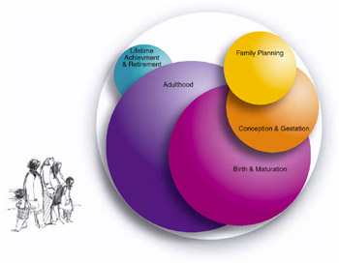

Slide 3
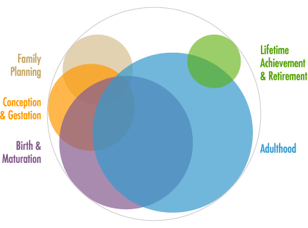

Slide 4
Persona family planning
Persona conception and gestation
Persona birth and maturation
Persona adulthood
Persona lifetime achievement, reuse, and retirement

Slide 5
Phase 1: persona family planning
Persona development begins with family planning; this is the research phase that precedes the actual creation of the personas.
Focus:
  Creating a core team 組成團隊
  Researching your organization to evaluate the problems and needs of your company or product – these needs that the persona effort will address 了解公司問題與需求
  User research and identification of data sources that will provide the raw materials for your persona. 使用者研究與資料蒐集

Slide 6
Phase 2: persona conception & Gestation 孕育
The team extracts useful information out of disparate data sources and uses this information to build personas.
  turn data into information
  turn information into personas.
Decide ---
  How many personas you will need 要多少persona
  Which descriptive elements you should include in persona documents 需要哪些描述性資料
  How to prioritize and validate your persona 排序
  How to decide when your persona are complete 如何確定何時完成，可以介紹給product team

Slide 7
Filter data and organize information – information that help understand user roles, user goals, and user segments.
Complete persona 完整的persona包含:
  Facts
  Narrative
  Storytelling elements
Design relevant information & extraneous information (e.g. a persona’s e-mail, favorite car or book)

Slide 8
Phase 3: persona birth and Maturation
You and your core team will send your personas into your organization to interact with other people.
Throughout the remainder of the development cycle, your personas will continue to develop in the minds of your product team.
  討論創造persona過程、如何有效使用persona
要做的事包含
  Create a persona campaign
  Introduce it to the product team
  Ensure the personas are understood and likely to be used
  Manage the minor changes to the personal descriptions

Slide 9
利用一些方法來介紹persona給設計團隊
  Web sites, poster, illustrations, electronic documents, diagrams, live actors, videos.

Slide 10
Phase 4: Persona adulthood
During Adulthood, personas are "all grown up" and they have a job to do. The organization will ‘know’ the personas;
It’s time to help everyone use the personas to inform the design and development of the product.
Persona can be used to
  Help you plan, design, evaluate, and release your products
  Inform marketing, advertising, and sales strategy

Slide 11
Phase 5: persona lifetime Achievement, Reuse & Retirement
At the end of the project, it’s important to measure the success of the persona effort and create a plan to reuse or retire the personas.
No matter how you create them, personas will make your customer data usable to the people designing your website, product, or service experience.
Well-crafted personas:
  形成對顧客/使用者概念的共識Create a rich, shared understanding of what you mean when you say ‘our customers’ or ‘our users’,
  專注在顧客目標，從資料中擷取精華，有共同溝通的語彙 ，使大家能消化及組織資料，同時記住顧客相關訊息 Encourage the entire organization to focus on your customers’ goals, Extract more value from data you’ve already collected for other purposes, Create a shared vocabulary between multiple departments in your organization and enable everyone to organize data, consume complexity, and recall facts related to your customers,
  利用所蒐集的資料 (創建persona用data)作為形成決定的依據 Personas Enable yourself and other stakeholders to make informed decisions about design alternatives-decisions that are supported by the data used to create the personas,
  在所蒐集的資料找出不足處，做為日後改善依據 Identify ‘holes’ in your existing data (and understanding of your customers) and establish a framework for future data collection,
  除去個團隊互動時的政治化 Depoliticize the interactions between various teams in your organization.

Slide 12
The persona lifecycle is designed to enhance, not replace, your existing processes
Persona 的建置要在waterfall model 之前，即在system requirement形成之前
Discount usability + persona, play a major role in 引導UCD發展 ---- figure 2.3 waterfall model + persona lifecycle

Slide 13
figure 2.4: UCD tools and methods grouped by product lifecycle phases
Planning & feasibility
requirements
design
implementation
Test & measure
Post release

Slide 14
Requirements
User surveys
Interviews
Contextual inquiry
User observation
Context
Focus group
Brainstorming
Evaluating existing systems
Card sorting
Affinity diagramming
Scenarios of use
Task analysis
Requirements meeting
Planning & feasibility
Stakeholder meeting
Analyze content
ISO 13407
Planning
Competitor analysis

Slide 15
Design
Design guidelines
Paper prototyping
Heuristic evaluation
Parallel design
Storyboarding
Evaluate prototype
Wizard of Oz
Interface design patterns
Implementation
Style guides
Rapid prototyping

Slide 16
Test & measure
Diagnostic evaluation
Performance testing
Subjective evaluation
Heuristic evaluation
Critical incidence technique
pleasure
Post release
Post release testing
Subjective assessment
User survey
Remote evaluation

Slide 17
Story from the field persona for e-business server products
電子商務server實例
Family planning
  創建組 Design usability team -- create, deliver, maintain, and insure its use by product team
  Stakeholders – program managers, feature developers, product marketers, user interface designers, technical writers, high-level product team managers
Identify user type –
  從公司資料庫中data，進行meta-analysis
  訂出三種user types: system administrator, developer, information worker (business end user) 系統管理者、開發者、資訊工作者(使用者)

Slide 18
建立task & skill sets
  應用Context inquiry方法
  Conduct field research at multiple e-business companies
Conception and gestation
Affinity grouping of the data --- outline the goals, responsibilities, tasks, skills, and tools per user
紀錄 key attributes of personas
確認persona真實性 (與stakeholder, subject matter experts, users)

Slide 19
Birth and maturation
A “name your persona” contest讓產品製作團隊能buy-in
  Sense of closeness and ownership
Life-size silhouettes (放置人形牌) + picture of real users
利用方法去 raise awareness and keep the product team interested
Adulthood 開始使用
Marketing部門
  開始使用 (marketing requirements documents and vision statements)
Product team部門
  用在 requirement documents, functional specifications
  Brainstorming, sketching, prototyping, and design recommendations
  將persona attribute用在scenario, tasks, pain points

Slide 20
Conduct persona-centric usability baseline studies (on key tasks)
在招募受測者時，使用persona 特性來 recruit the appropriate participants
Lifetime achievement and retirement
Increase the product teams’ awareness of the target audience and its goals, skills, and top tasks.
在管理階層、meeting、 email中不斷被提到
用來點出最重要的工作任務及痛點 highlight the most important tasks and pain points they experience performing those tasks with our product.
汰換persona

Slide 21
Putting it all together: the persona lifecycle in action

Slide 22
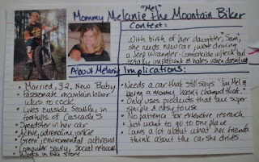
Taking each role in turn, turn the attribute descriptions into a believable person(a). On a large size index card
  Give the persona a name and age.
  It often helps to give them a two to five word tag-line (Abby the AOL Mom, Nicolas the Knowledge Worker, Ichiro the IT Pro).
  Say what they do in life. Are they a student, a business person, retired?
  What is their level of comfort with technology? How experienced are they in the topics your product will address?

Slide 23

Persona success stories
Universal Orlando sketched out personas, each with a different set of motivators and travel needs. Online ticket purchases, a key metric for the resort, are up almost 80 percent year to date. "It's beyond demographic, beyond male/female, young/old. It gets into the psychology of how humans make decisions and how they get comfortable making decisions.”
http://www.questionablemethods.com/2011/11/thumbnail-personas-make-users-real.html
Notes:
http://www.questionablemethods.com/2011/11/thumbnail-personas-make-users-real.html

Slide 24
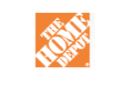

Home Depot uncovered two very different customers who might have identical demographic profiles: the do-it-yourselfer who wants to pick out all the cabinets and appliances and the customer who wants a kitchen designer to do it all.
Staples’ online revenue went from $3 billion to $4.9 billion within two years after a major site redesign that included the development of seven personas and a decision to design primarily for the two most important ones.

Slide 25
Ten Steps to Personas
http://www.hceye.org/HCInsight-Nielsen.htm

